Slide 1
Example: ToDo List
ToDo List Components | ToDo Items Components | Deleting Tasks | Usability Improvements
Notes:
Welcome to our lecture on List example. In this lecture we will go through an example called as to do list and we will explore the to do list components, to do items components, how to delete tasks from list, and usability improvements. Let’s start the video lecture.

Slide 2
ToDo List Components
Create a React app using Create React App, which generates a new project with an App.js file.
Implement a TodoList component with a controlled input, an Add button, and a task list.
Use state variables to track the input value and the array of task items, allowing users to add and delete tasks.
Notes:
Welcome to this lesson on building a To Do List in React. We start by creating a new React app, which includes an App.js file. The core of our app is the To Do List component, which consists of a controlled input, an Add button, and a task list. We use state variables to track both the input value and the list of tasks, allowing users to add and remove items dynamically.

Slide 3
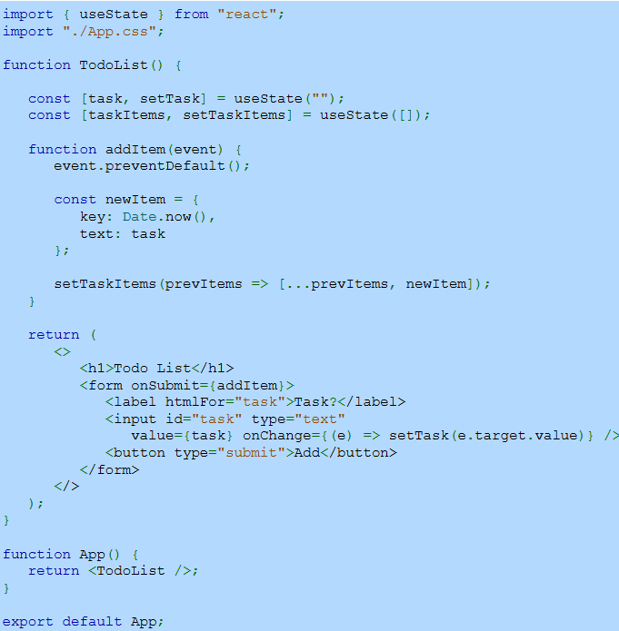
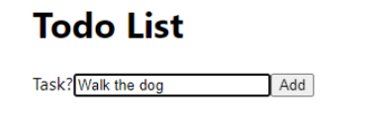
Example
Notes:
Now, let's look at an example of the To Do List component. We use state to manage the input value and task list. When the user types in the input field, the state updates. Clicking the Add button triggers a function that prevents the default form submission, creates a new task, and updates the task list. The updated list is then rendered dynamically on the screen.

Slide 4
Todo Items Components
TodoItems component displays a list of tasks in an ordered list.
It receives the task items as props from the parent component.
Add this component above or below the TodoList component in App.js.
Notes:
Now that we have a way to add tasks, let's display them using the To do Items component. This component renders a list of tasks in an ordered format. It receives the task list as props from the parent component. We can place this component either above or below the To do List in the main app file to organize and display tasks effectively.

Slide 5
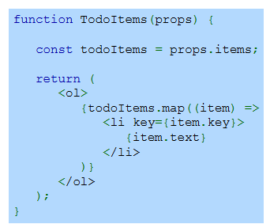
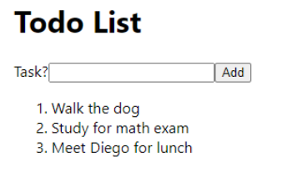
Example
Notes:
Now, let's look at how the To do Items component displays tasks. It receives the task list as props from the parent component. Inside the component, we use a mapping function to iterate over the tasks and render them as list items. Each item is assigned a unique key for efficient updates. The result is a neatly displayed ordered list that updates dynamically as tasks are added.

Slide 6
Deleting Tasks
Each task item has an X button to allow deletion.
Clicking the X button triggers deleteItem() in TodoList, removing the task from the array.
React re-renders the list without the deleted item.
Notes:
Now that we can add tasks, let's enable task deletion. Each task item includes a button to remove it from the list. Clicking this button triggers a function in the To do List component, which removes the task from the array. React then re-renders the list, updating the display without the deleted task. This makes managing tasks more interactive and efficient.

Slide 7
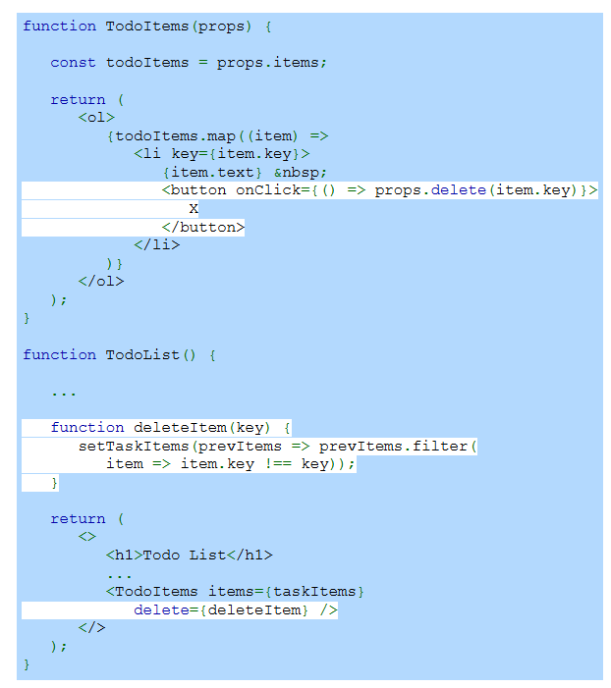
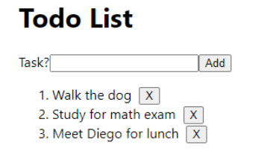
Example
Notes:
Continuing from the previous slide, we now implement task deletion. Each task item includes a button that calls a function when clicked. This function filters the task list by removing the selected item. The updated list is then passed back to the component, triggering React to re-render the list without the deleted task. This keeps the to-do list dynamic and responsive.

Slide 8
Usability Improvements
Auto-focus the input field after adding a task for quicker entry.
Prevent empty tasks by disabling the Add button or validating input.
Allow Enter key to submit tasks without clicking the Add button.
Notes:
Now that our to do list is functional, let's improve usability. First, we can auto-focus the input field after adding a task to speed up entry. Next, we should prevent empty tasks by disabling the Add button or validating input. Finally, allowing users to press the Enter key to submit tasks makes the experience smoother and more intuitive.

Slide 9
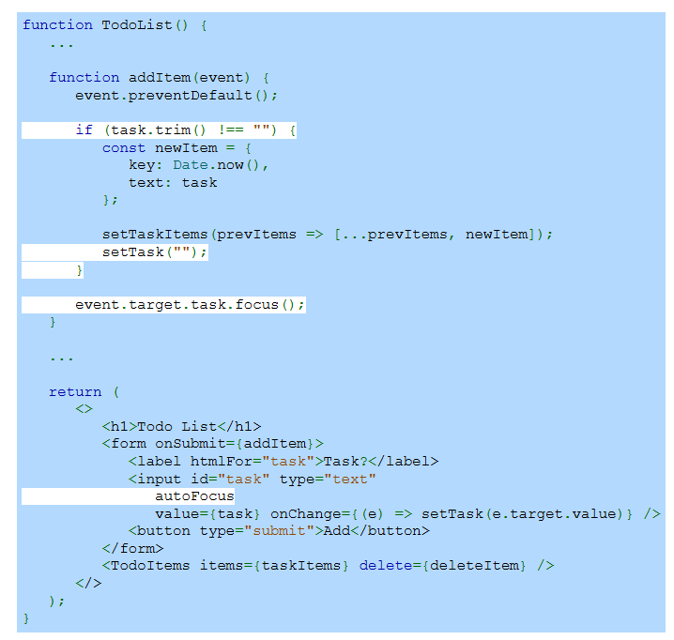
Example
Notes:
Now, let's implement usability improvements in our to do list. First, we prevent empty tasks by checking if the input is blank before adding it. Next, after a task is added, the input field is cleared and automatically focused for quicker entry. Lastly, we use an attribute in the input element to ensure it is always ready for user input, improving efficiency.

